Slide 1
Week 1a : Introduction

Slide 2
This class
Contents of this course
Evaluation of this course
Some bureaucracy
Get our hands dirty with Unity

Slide 3
What are you all hoping to learn in this course?

Slide 4
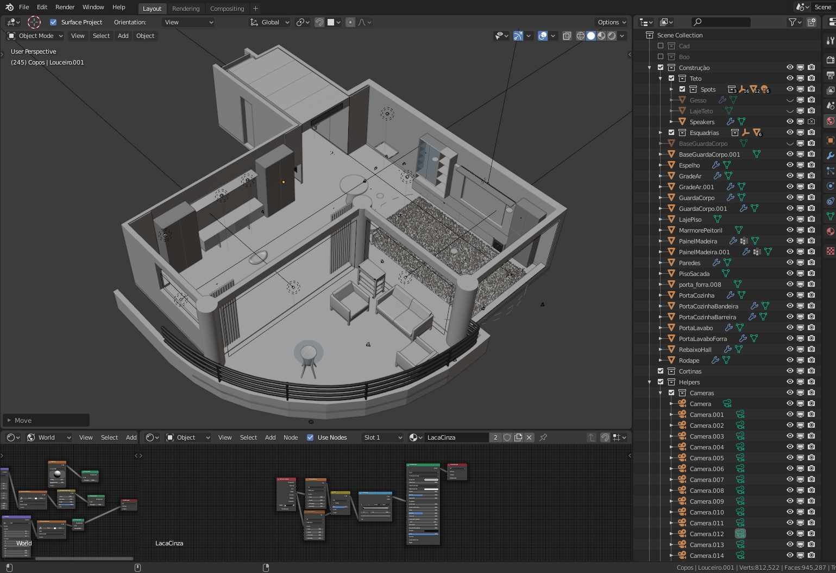
What are “3D graphics”?
“Images representing a 3d scene created by transforming 3d models and textures using algorithms”
This is not *the* definition, this is my definition
It’s a badly defined term

Slide 5
Models and textures

Slide 6
Creating 3D graphics
We need to create 3D models : 3D modelling
We need to create textures : 3D texturing
We need to transform them : ??? Does anyone know the term ???

Slide 7
This course should be called 3D rendering
Rendering : creating an image based on a description of a scene using algorithms
“3D graphics programming” would also be a good name for this course

Slide 8
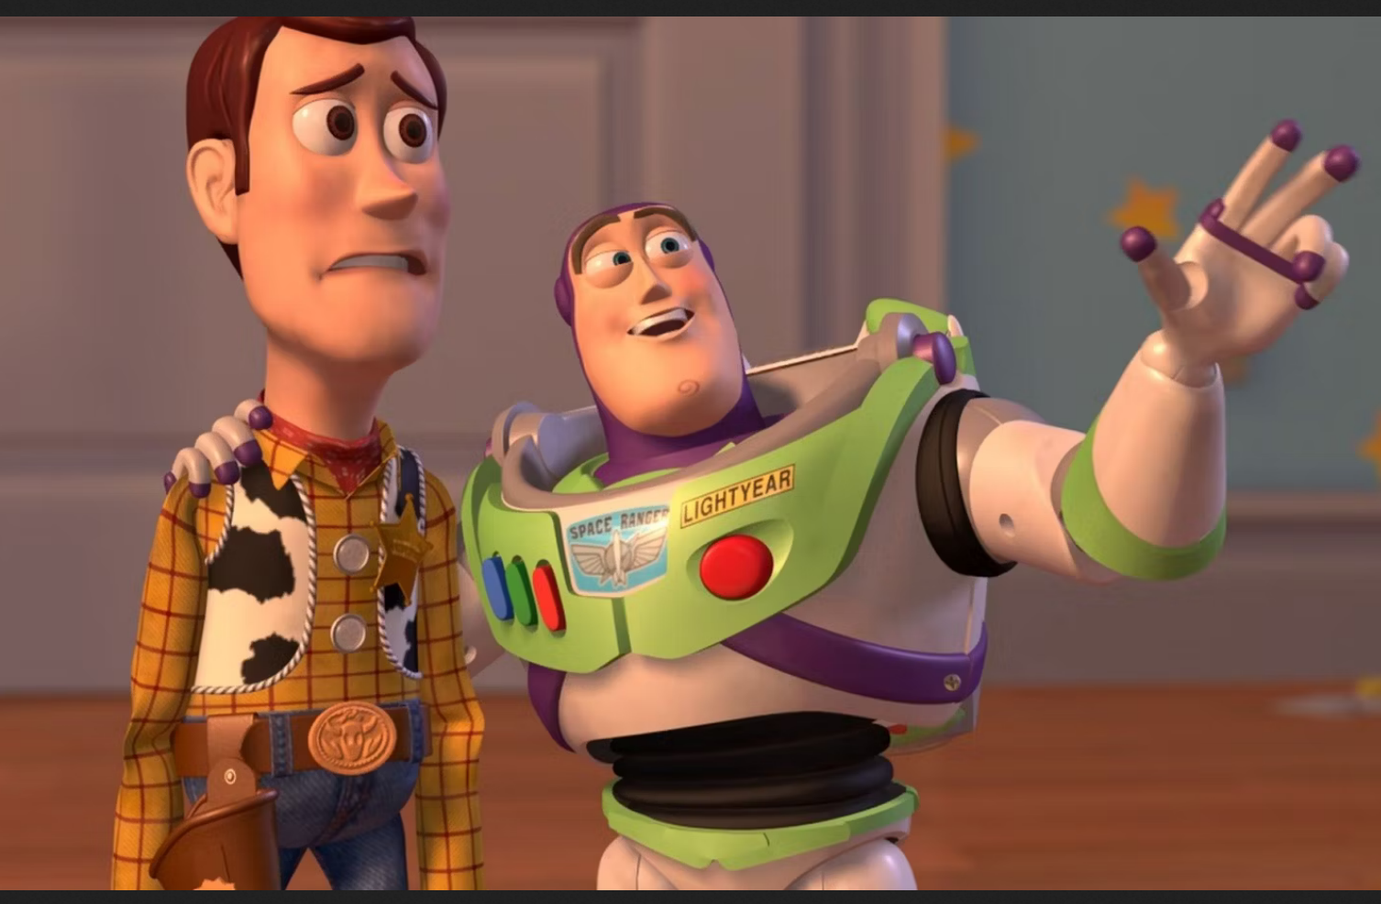
Course schedule

Slide 9
Evaluation
8 points on lab exercises
12 points on project
Oral exam defending both
Danger : oral exam checks you understand what you did in the exercizes and project. It a defence, but it’s also an oral exam of the theory as you used it.

Slide 10
How to succeed at this course
Understand the different parts thoroughly
Have an overview how they connect
Do the labs and projects slowly, building on solid work
Try to think of things you don’t understand, and ask (other students or me)
Be curious

Slide 11
How to fail at this course
Skip class
Use ChatGPT for your labs/project, and never investigate when it “seems to work”
Randomly fiddle with code : multiply by -1, reorder terms,…..
Use terms in the wrong way
Hand in late

Slide 12
Code of conduct
Classes aren’t mandatory, but very strongly recommended. In my experience, people who come to class are the ones that pass
Be punctual. If you’re late due to unforeseen circumstances, enter quietly. Don’t come late every week
Be very punctual with deadlines. Being late is losing half of the maximum of points. Aim to hand in half an hour early.
Same with leaving early. Let me know before the start of class, and sit in the back
Be quiet during the presentation, I’m very easily distracted.

Slide 13

Send me an email!
I will respond in 4 working days at the latest
I might miss you on Toledo or Teams, just send me an email
I never get enough emails from my students

Slide 14
Recap

Slide 15
Next week

